Slide 1
ORM. JPA. LAYERED ARCHITECTURE
Volodymyr Paziuk

Slide 2
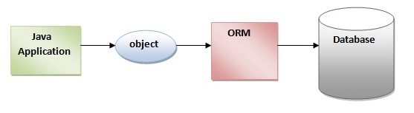
ORM
Object-Relational Mapping (ORM) is a technique for mapping between object-oriented systems and relational databases. This creates, in effect, a "virtual object database" that can be used from within the programming language.

Slide 3
Advantages and disadvantages of ORM
+ ORM frees the programmer from dealing with simple repetitive database queries.
+ Automatically mapping the database to business objects lets programmers focus more on business problems and less with data storage.
+ The mapping process can aid in data verification and security before reaching the database.
+ ORM can provide a caching layer above the database.
- ORM adds a least one small layer of application code, potentially increasing processing overhead.
- ORM can load related business objects on demand.
- An ORM system's design might dictate certain database design decisions.

Slide 4
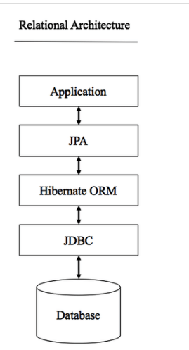
Architecture

Slide 5

What was before
public List getEmployees() { try { Class.forName("com.mysql.jdbc.Driver"); } catch (ClassNotFoundException e) { e.printStackTrace(); } Connection connection = null; try { connection = DriverManager.getConnection( "jdbc:mysql://localhost:3306/v_paziuk", "root", "root"); Statement stmt = null; stmt = connection.createStatement(); ResultSet rs = null; if (stmt != null) { rs = stmt.executeQuery("select * from employees"); } while (rs.next()) // connection.close(); } catch (SQLException e) { e.printStackTrace(); }

Slide 6
Fetch using ORM
Session session = sessionFactory.openSession();
(List<Employee>)session.createSQLQuery("SELECT * FROM Employee") .addEntity(Employee.class).list();

Slide 7
What is persistence?
Persistence in computer science, is an adjective describing data that outlives the process that created it. Java persistence could be defined as storing anything to any level of persistence using the Java.

Slide 8
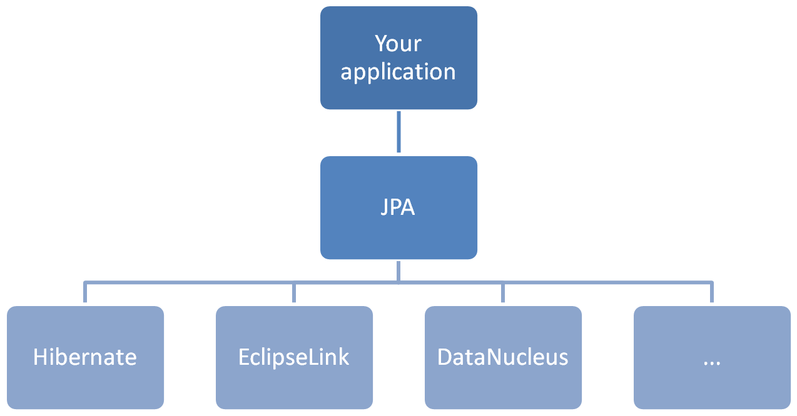
Java Persistence API
JPA(Java Persistence API) is a specification that provides guidelines to implement an ORM tool, like Hibernate. It is only a specification and can not provide any concrete functionality to your application. Its only purpose is to provide a set of rules and guidelines that can be followed by JPA implementation vendors such as Hibernate, iBATIS, Eclipse link etc. to create an ORM implementation in a standardized manner.

Slide 9
Quoting Spring Data JPA’s documentation:
Implementing a data access layer of an application has been cumbersome for quite a while. Too much boilerplate code had to be written. Domain classes were anemic and haven't been designed in a real object oriented or domain driven manner.
Using both of these technologies makes developers life a lot easier regarding rich domain model's persistence. Nevertheless the amount of boilerplate code to implement repositories, especially is still quite high. So the goal of the repository abstraction of Spring Data is to reduce the effort to implement data access layers for various persistence stores significantly.

Slide 10
JPA Structure
JPA consists of three main points:
API – interfaces in the package javax.persistance Set of interfaces that allow you to collaborate with ORM provider.
JPQL – object query language. Very similar to SQL, but the requests are to objects.
Metadata – annotations on objects. Set annotations, which helps us to describe metadata display. Then JPA already knows what to which table you want to save. Metadata can be described in two ways: XML file or through annotations.

Slide 11
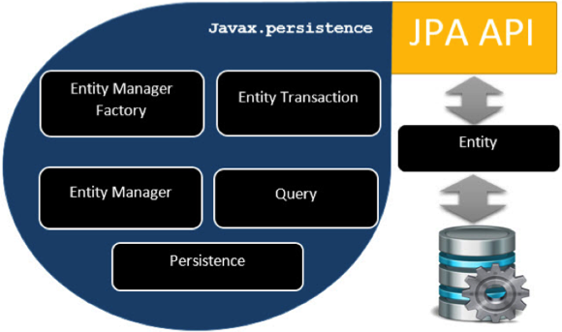
JPA Interfaces
EntityManagerFactory - used to interact with the entity manager factory for the persistence unit;
EntityManager – used to interact with the persistence context (with the database session);
EntityTransaction - used to control transactions on resource-local entity managers;
Query – used to control query execution;

Slide 12
Entity manager settings
Settings are stored in the file persistence.xml in the folder META-INF.
In this file:
determine the unit-name;
point provider (Hibernate, ...);
you can list the classes (entity) or through annotations;
properties – provider properties (connection to the database - url, login, password)

Slide 13
Example

Slide 14

What is now
public interface EmployeeRepository extends CrudRepository<Employee, Long> {. Employee findByEmpNo(String empNo); List<Employee> findByFullNameLike(String fullName); List<Employee> findByHireDateGreaterThan(Date hireDate); }

Slide 15
The Two Pillars of a Good Architecture
1. The Separation of Concerns (SoC) Principle
Separation of concerns (SoC) is a design principle for separating a computer program into distinct sections, such that each section addresses a separate concern.
2. The Keep It Simple Stupid (KISS) principle
Most systems work best if they are kept simple rather than made complicated; therefore simplicity should be a key goal in design and unnecessary complexity should be avoided.

Slide 16
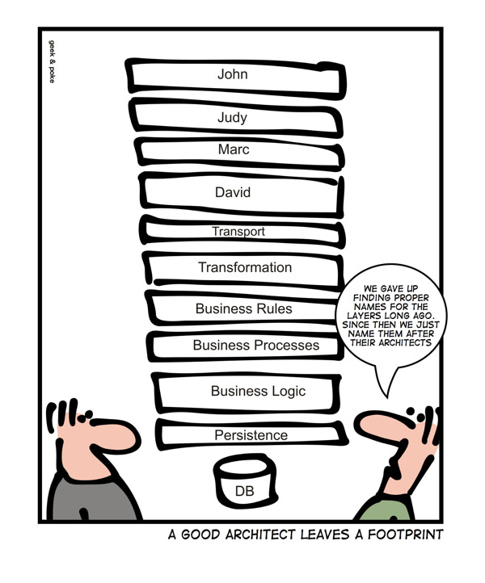

Slide 17
Concerns of web application
It needs to process the user’s input and return the correct response back to the user.
It needs an exception handling mechanism that provides reasonable error messages to the user.
It needs a transaction management strategy.
It needs to handle both authentication and authorization.
It needs to implement the business logic of the application.
It needs to communicate with the used data storage and other external resources.

Slide 18
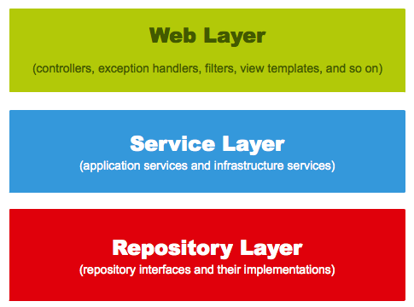
Web layers

Slide 19
The web layer is the uppermost layer of a web application. It is responsible of processing user’s input and returning the correct response back to the user. The web layer must also handle the exceptions thrown by the other layers. Because the web layer is the entry point of our application, it must take care of authentication and act as a first line of defense against unauthorized users.
The service layer resides below the web layer. It acts as a transaction boundary and contains both application and infrastructure services. The application services provides the public API of the service layer. They also act as a transaction boundary and are responsible of authorization. The infrastructure services contain the “plumbing code” that communicates with external resources such as file systems, databases, or email servers. Often these methods are used by more than a one application service.
The repository layer is the lowest layer of a web application. It is responsible of communicating with the used data storage.

